Slide 1

Amazon Sales Data Analysis
Report by: Deepan R
UNID: UMIP5710

Slide 2
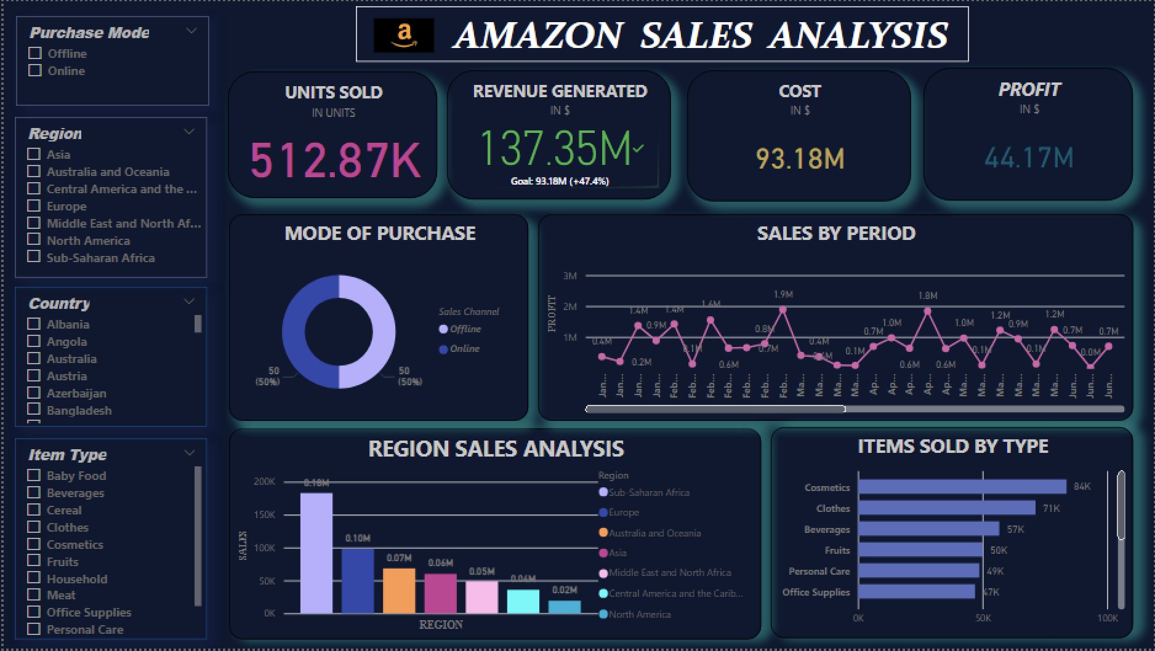

Slide 3
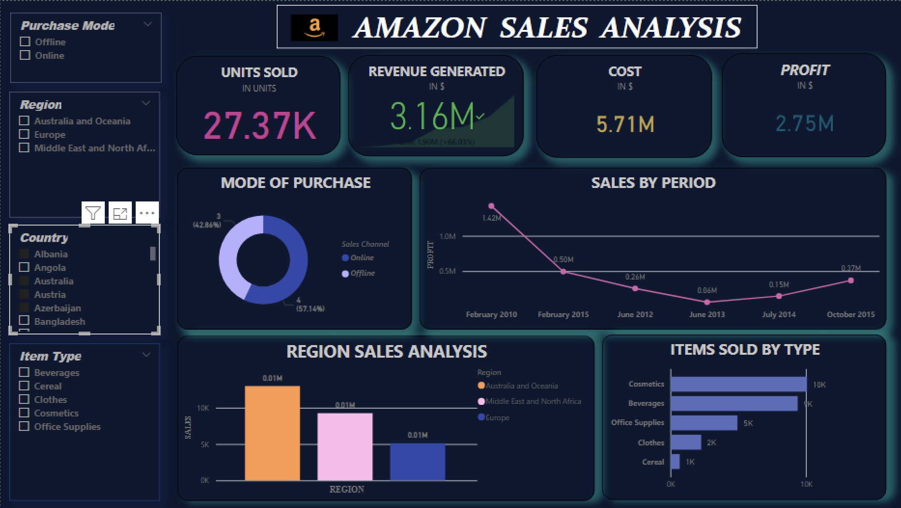
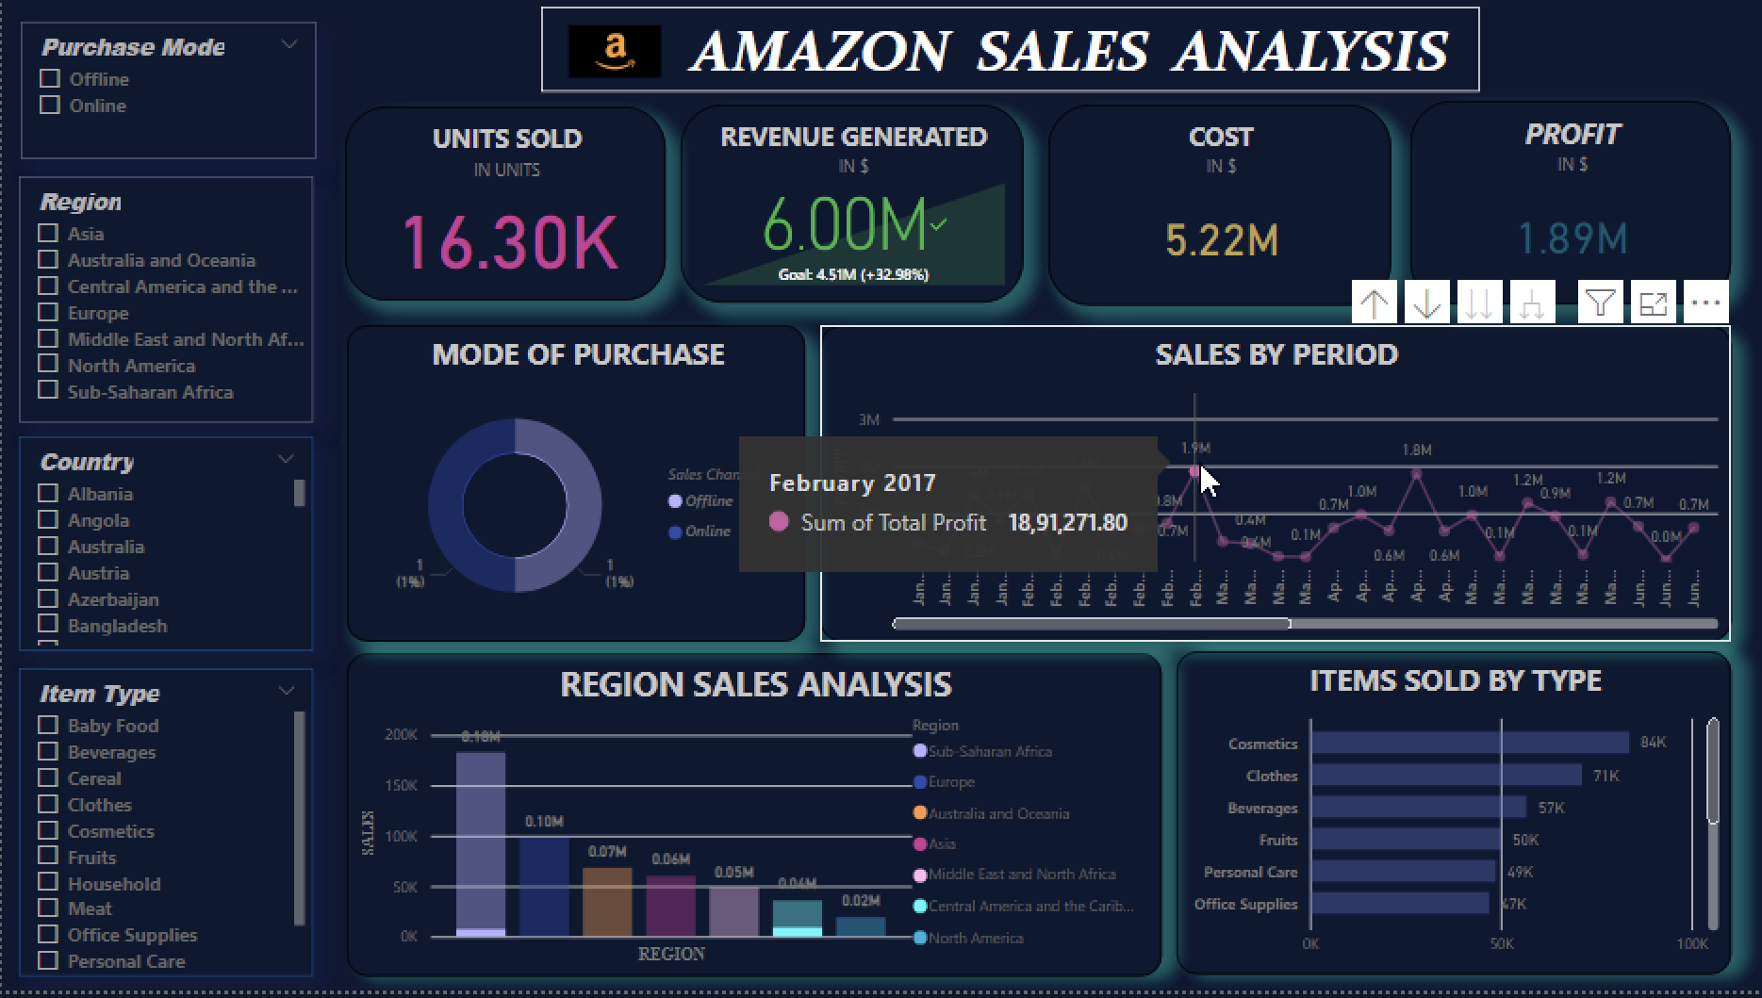
Dashboard with slicers

Slide 4
Attributes
Region
Country
Sales Channel
Order Date
Units Sold
Item Type
Total Renue
Total Cost
Total profit

Slide 5
Data used for Analysis
Region includes 7 regions including Asia, Europe, Australia and Oceania etc.
Similarly 76 countries are used as slicers and dicers for accurate region wise analysis
Two sales channel options are available – Online or offline
Item types that are sold with amazon are Baby food, cereal, Beverages, Household, Office supplies etc.
Revenue is the amount which is earned by selling products
Cost is the real price of the product without profit amount
Profit is calculated by subtracting cost from revenue generated

Slide 6
Analysis Phase - I
Total Revenue generated in Amazon is 137.35 Million Dollars
Total Cost generated in Amazon is 93.18 Million Dollars
Total Profit generated in Amazon is 44.17 Million Dollars
Total products sold in Amazon according to this dataset is 5,12,872 units
Total profit is calculated by : Profit = Revenue – Cost
With the above formula, profit is been calculated to 44M $ which is almost half of cost and 1/3 of revenue generated
The analysis can also be done accurately and to minimized level by using slicers and dicers options available in the dashboard. For example, Sales detail of baby food sold in Sri Lanka, Asia

Slide 7
Analysis Phase - II
The main part of Analysis comes here, the main analysis
According to the dataset and Dashboard:
The Sales channel is distributed equally that is, in both mode of purchase –Offline and Online the products were bought in almost equal amount 50-50
Cosmetics has been sold most, almost 1/6 of products sold has been cosmetics followed by Clothes and Beverages
Product with least sales is Meat and Snacks with 11k and 14k units respectively
On the analysis of time period, we can observe that 2012 has been the peek year of sales but 2011 has been the worst year of sales
On observing region wise sales Sub Saharan Africa has the greatest market for Amazon and North America has the Market with least sales for Amazon
The analysis can be done further and more reasonable by using slicers for maximized information region wise, item type wise, sales of period etc.

Slide 8
THANK YOU !

